Slide 1
Text summarization
Yufeng Lv
10/15/2018

Slide 2
Types
No. | Types of summary | Factors
1. | Single and multi-document | Number of documents
2. | Extractive and abstractive | Output (if extract or abstract is required)
3. | Generic and query-focused | Purpose (whether general or query related data is required)
4. | Supervised and unsupervised | Availability of training data
5. | Mono, multi and cross-lingual | Language
6. | Web-based | For summarizing web pages
7. | E-mail based | For summarizing e-mails
8. | Personalized | Information specific to a user's need
9. | Update | Current updates regarding a topic
10. | Sentiment-based | Opinions are detected
11. | Survey | Important facts regarding person, place or any other entity

Slide 3
Types
No. | Types of summary | Factors
1. | Single and multi-document | Number of documents
2. | Extractive and abstractive | Output (if extract or abstract is required)
3. | Generic and query-focused | Purpose (whether general or query related data is required)
4. | Supervised and unsupervised | Availability of training data
5. | Mono, multi and cross-lingual | Language
6. | Web-based | For summarizing web pages
7. | E-mail based | For summarizing e-mails
8. | Personalized | Information specific to a user's need
9. | Update | Current updates regarding a topic
10. | Sentiment-based | Opinions are detected
11. | Survey | Important facts regarding person, place or any other entity

Slide 4
Data sets
DUC(2001-2007)/TAC(2008-)
Text summarization competition dataset, for model evaluation
Gigaword
include 9,500,000 news articles, using headline for summary
for single sentence summarization
CNN/Daily Mail
multi-sentence summary
Large Scale Chinese Short Text summarization Dataset(LCSTS)
A Short Text Chinese dataset, from Sina Weibo.
2,400,591 short text, summary pairs/10,666 human labeled pairs

Slide 5
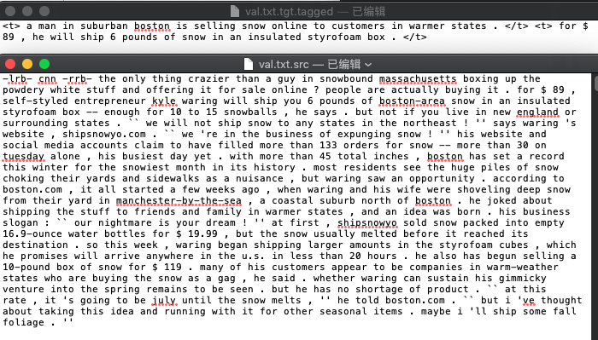

Slide 6
Evaluation——ROUGE
Rouge-N (unigram, bigrams, trigrams, etc)
Rouge-L (summary level LCS)
Rouge-W(Weighted LCS)
Rouge-S (skip-gram)
Rouge-SU (skip-gram with unigrams)

Slide 7
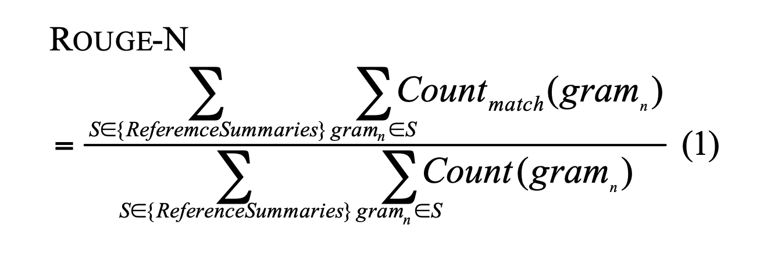
Rouge-N

Slide 8
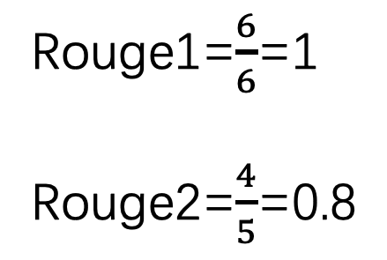
Rouge-N
Auto summary: the cat was found under the bed
Ref summary: the cat was under the bed
No | 1-gram | ref 1-gram | 2-gram | ref 2-gram
1 | the | the | the cat | the cat
2 | cat | cat | cat was | cat was
3 | was | was | was found | was under
4 | found | under | found under | under the
5 | under | the | under the | the bed
6 | the | bed | the bed
7 | bed
count | 7 | 6 | 6 | 5
Rouge1=$\frac{6}{6}$=1
Rouge2=$\frac{4}{5}$=0.8

Slide 9
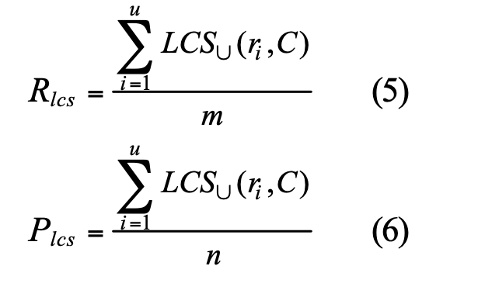
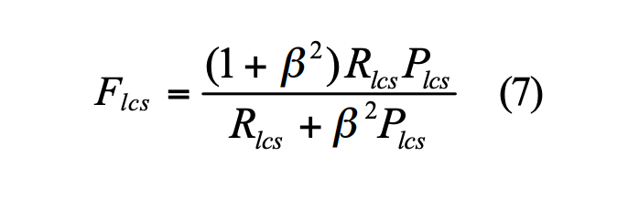
Rouge-L(Longest Common Subsequence)
Notes:
其中LCS(X,Y)LCS(X,Y)是X和Y的最长公共子序列的长度，m,n分别表示参考摘要和自动摘要的长度（一般就是所含词的个数），Rlcs,Plcs分别表示召回率和准确率。最后的Flcs即是我们所说的Rough-L。在DUC中，β被设置为一个很大的数，所以Rough_L几乎只考虑了Rlcs，与上文所说的一般只考虑召回率对应。

Slide 10
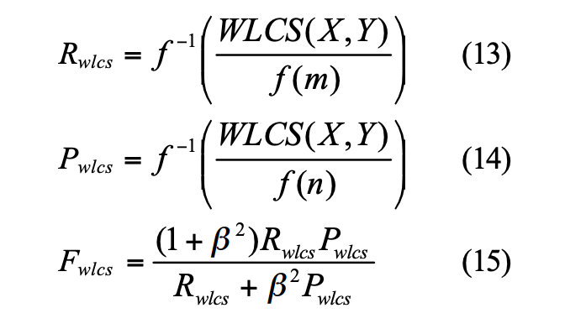
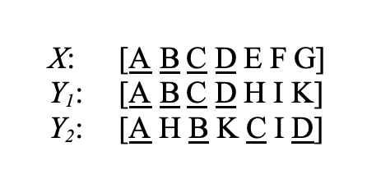
Rouge-W

Slide 11
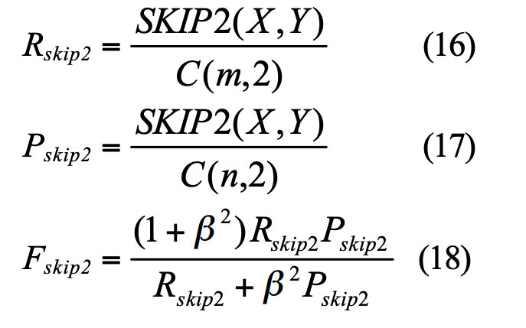
Rouge-S/Rouge-SU
To achieve this, we extend ROUGE-S with the addition of unigram as counting unit.
Notes:
使用了skip-grams，在参考摘要和待评测摘要进行匹配时，不要求gram之间必须是连续的，可以“跳过”几个单词，比如skip-bigram，在产生grams时，允许最多跳过两个词。比如“cat in the hat”的 skip-bigrams 就是 “cat in, cat the, cat hat, in the, in hat, the hat”.

Slide 12
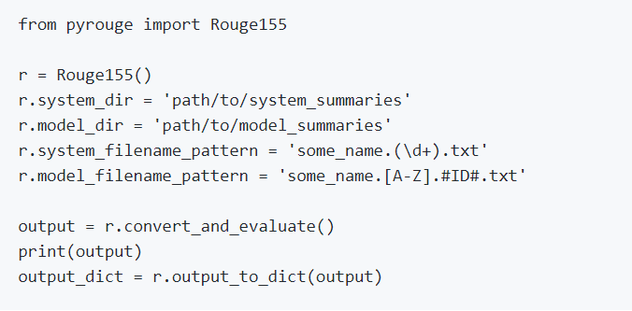
PyRouge

Slide 13
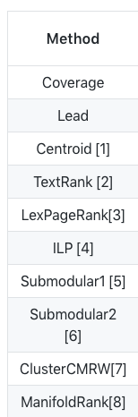
Useful tools
PKUSUMSUM:
Single-document
Multi-document
Topic-based Multi-document
HanNLP
TextRank

Slide 14
State of the art
RNN based
CNN based
Attention
Reinforement

Slide 15
RNN based

Slide 16
RNN + Attention
Notes:
文中使用了两套attention机制，Intra-temporal attention和Intra-decoder attention。前者是作用在encoder中上的，对input中每个词计算权重，这样能使生成的内容信息覆盖原文。后者是作用在decoder上的，对已经生成的词也计算权重，这样能够避免生成重复的内容。然后两者拼接起来进行decode生成下一个词。

Slide 17
Model + Reinforement learning
Notes:
Free-running mode. 靠前的state中如果出现了极差的结果，后面的全部state都会受影响
Teacher-Forcing mode。每次不使用上一个隐状态的输出作为下一个隐状态的输入，而是直接使用ground truth的对应上一项作为下一个隐状态的输入，这样做能使得较快地生成正确的结果，但也会过于依赖数据，training时效果很好，testing时无ground truth数据效果变差。

Slide 18
ConvS2S based
Notes:
IJCAI 2018｜腾讯知文等提出结合主题信息和强化训练生成更优摘要

Slide 19
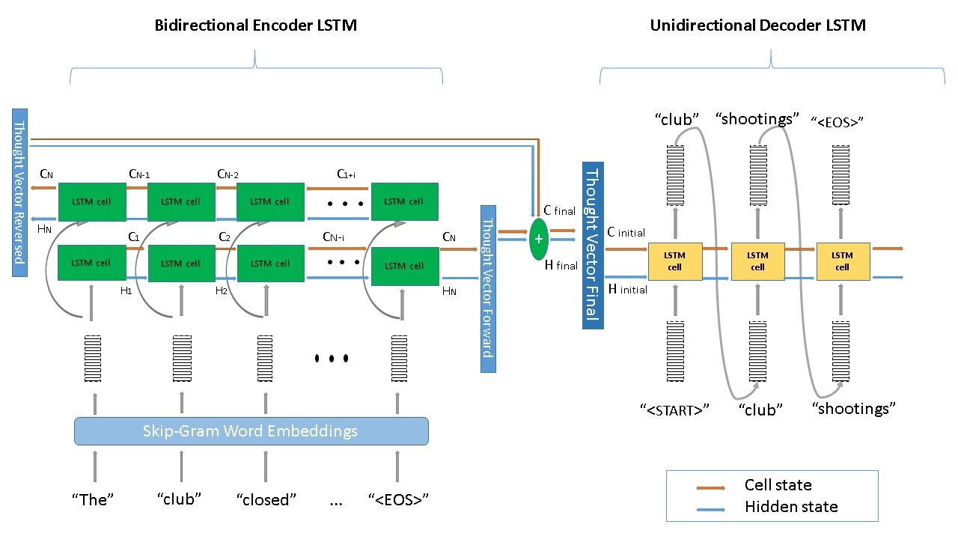

Slide 20
Our destiny
Combine UGC and PGC
Extractive or abstractive?
UGC from Zhihu, Baidu Baike, etc. —— unsupervised
UGC + PGC —— multi-document
PGC——Long Text
The other problem, how to get the structured UGC data for training

Slide 21
Method
Two baseline:
RNN+Attention
ConvS2S+Attention
GANs?
Wang Y S, Lee H Y. Learning to Encode Text as Human-Readable Summaries using Generative Adversarial Networks[J]. 2018.
Joint learning(multi-task)?
Salesfore's decaNLP: 10 NLP task for 1 model
Some awesome ideas for specific issues
topic attention
Minimum Risk Training

Slide 22
Discussion？

